Slide 1

In Bound and Out Bound Marketing

Slide 2
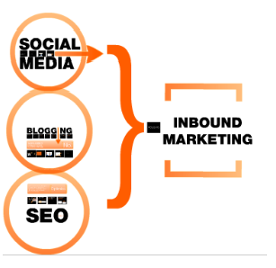
Inbound Marketing - Leverages All Three
Social media amplifies the impact of your content.
When your content is distributed across and discussed on networks of personal relationships, it becomes more authentic and nuanced, and is more likely to draw qualified customers to your site.
Source: HubSpot 2011, Inbound Marketing – The Next Phase of Marketing On The Web

Slide 3
Inbound Marketing =Content Creation
At the core of inbound marketing is - publishing compelling content that attracts inbound links and potential buyers to your website.
Fundamentally, inbound philosophy is – fulfilling research needs with passionate, entertaining, relevant and FREE information.
HubSpot Founder Dharmesh Shah reports that customers who blog regularly average about six times more inbound leads than those who don’t.

Slide 4
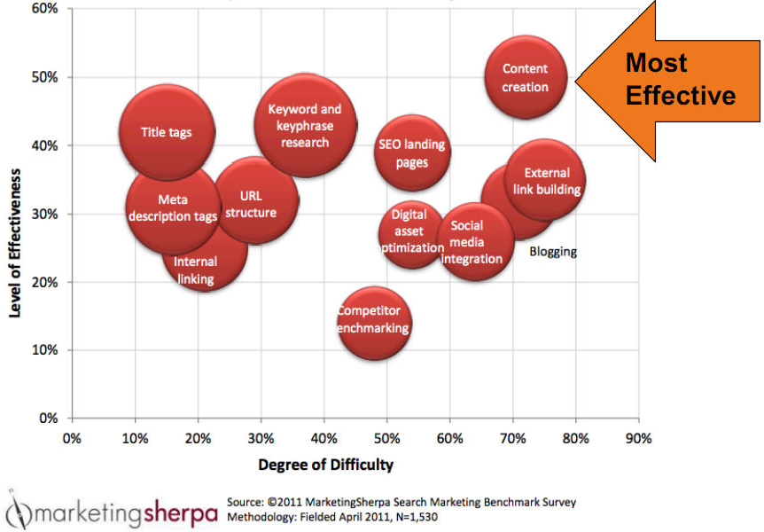
Correlating Content Creation Effort & SEO Effectiveness

Slide 5
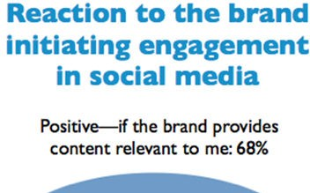
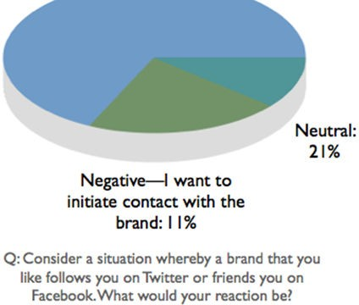
Brands initiating social media contact – what works? Content
Source: Newmediaandmarketing.com The Bond Between Moms and Brands

Slide 6
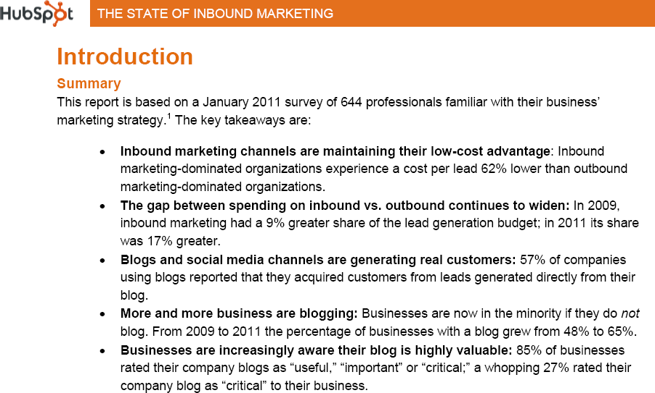
Inbound Marketing: Blogging
Source: HubSpot, The State of Inbound Marketing Report, 2011

Slide 7
Content Formats
Video
Podcast (MP3, M4A, .MOV, AVI)
Webinar (.MOV)
PowerPoint (.PPT)
RSS Feed – XML
Documents (PDF)
QR Code
Images, Graphics, Charts, Infographic
HTML, Text

Slide 8
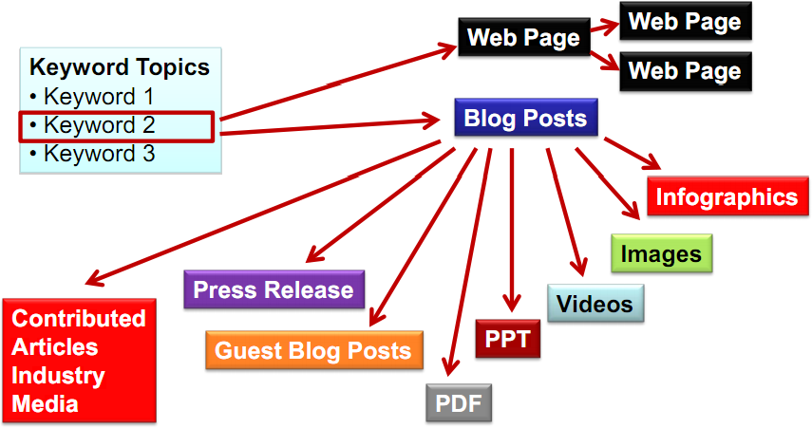
Content – Keyword Driven
Source: Lee Odden, TopRankMarketing.com, SES 2011 (June)

Slide 9
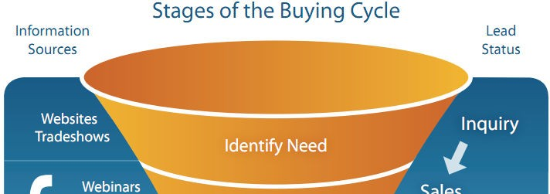
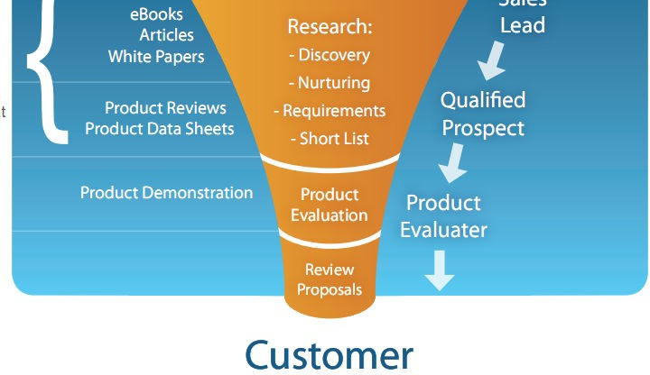
Content Targeting in Buying Funnel
Source: RealTime Publishers - Getting Your IT Product on Your Prospects Short List

